Slide 1
Understanding Influence Maximization via Higher-Order Decomposition
Zonghan Zhang, Zhiqian Chen
Computer Science and Engineering
Mississippi State University

Slide 2
Agenda
Motivation and Problem Setup
Introduction to Sobol Indices
Influence Decomposition with Sobol Indices
Proposed Method for IM
Empirical Experiment

Slide 3
Motivation
Influence Maximization: to find a set of seeds that maximizes the expected influence spread.
Two traditional streams of methods:
Simulation-based methods
Proxy-based methods

Slide 4
Motivation
Neither offers consistently trustworthy solutions in a timely manner.
Simulation-based: too slow, not scalable.
Proxy-based: cannot guarantee approximation ratio.
Overcome the issues by combining the simulation with the proxies.

Slide 5
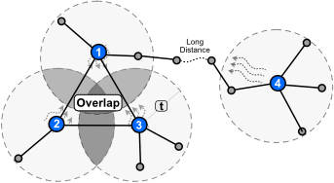
Motivation
Lack of tools for influence decomposition.
Current tools have various drawbacks.
Investigate and understand the influence spread from a higher-order
perspective.

Slide 6


Our Problem Setup
On a bi-directional graph G = (V, E), a k-sized seed set Ω has an expected influence spread б(Ω).
Explain the contribution of a seed from a higher-order perspective:
Design an efficient and effective IM schema:

Slide 7
Agenda
Motivation and Problem Setup
Introduction to Sobol Indices
Why introduce?
Influence Decomposition with Sobol Indices
Proposed Method for IM
Empirical Experiment

Slide 8
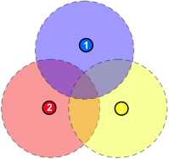
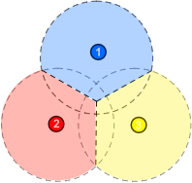
Comparing with Shapley
And why Sobol indices work better here?
Sobol total effect:
Better for node selection
Shapley value:
Better for contribution decomposition

Slide 9


Sobol Indices
A family of variance-based sensitive analysis methods.
Decompose a function into
where
and similarly for the higher-order terms.

Slide 10





Sobol Indices
First-order effect:
Variance of a variable set:
Higher-order effect:
We have:
Total effect:
Notes:
https://latex.codecogs.com/eqneditor/editor.php
1 equation per slide

Slide 11
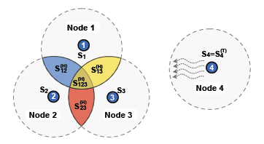
Explanatory Method
Define node selection as binary variables.
The randomness in the model is brought by the uncertainty in the influence process.

Slide 12




Explanatory Method
First-order effect: where
First-order effect of a set:
Higher-order effect:
Global contribution of a node by the Sobol total effect:

Slide 13
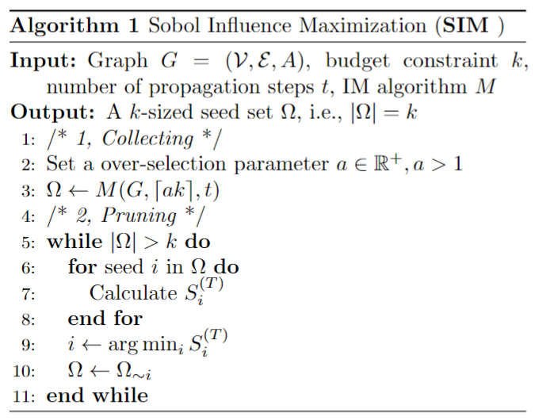
Proposed Model: SIM
Notes:
Overview + one by one

Slide 14
Collecting and Pruning
Collecting: |ak| candidates are identified with SOTA proxy-based IM algorithms, where a is an arbitrary constant.
Pruning: Extra nodes with lower Sobol total index need to removed, one at a time.
Time complexity:

Slide 15
Experimental Setup
Datasets:
Five real-world networks
Two synthetic networks

Slide 16
Experimental Setup
Six baselines:
GRD on Cora only.
DEG/EIG on both LT/IC. DD/Sigma/Pi only on IC.

Slide 17
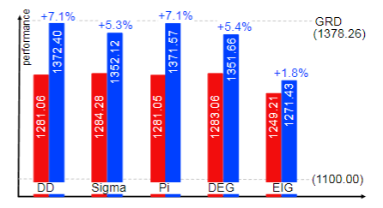
Results
Performances on Cora with IC comparing to GRD. Without SIM. With SIM.
SIM enhances the IM performance by a ratio up to 7%. SIM+DD: 965.03 (s) vs. GRD: 34871.65 (s).

Slide 18
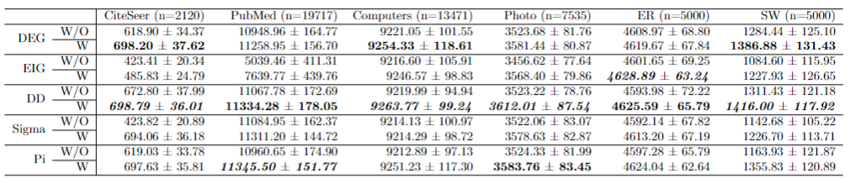
Results
IM performance (i.e., influence spread) with (W) and without (W/O) SIM under IC model.
Combining the degree discount heuristic with SIM always achieves the best or the second best performance among the algorithms.

Slide 19
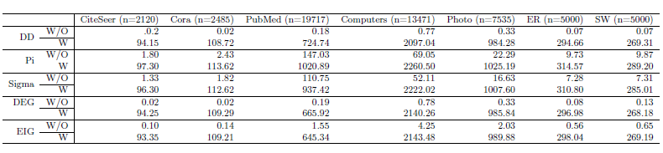
Results
The time cost of pruning extra nodes does not scale with the graph size.
SIM runs faster on more sparse graphs.

Slide 20
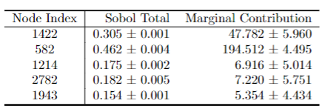
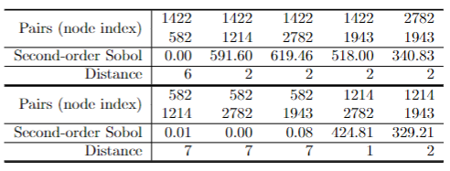
Results
The Legitimacy of Each Seed's Relative Contribution.
The second-order Sobol indices vs. distance.
Notes:
Show fig

Slide 21



Q&A
Thank you!
Code Here ↓
My Website ↓

